Slide 1
TSP- AI ML Fundamentals (Capstone Project)
HEART DISEASE PREDICTION
Presented By :
Student Name : UMA PRIYA C – NM ID : F6AF8CBA0F82A89BEFE432130AB8FB6D
College Name : Anna University Regional Campus –Tirunelveli
GUIDED BY: Ramar Bose

Slide 2
OUTLINE
Problem Statement (Should not include solution)
Proposed System/Solution
Algorithm & Deployment
GitHub Link
Project Demo(photos / videos)
Conclusion
Future Scope
References

Slide 3
Problem Statement
Heart disease can be managed effectively with a combination of lifestyle changes, medicine and,
in some cases, surgery. With the right treatment, the symptoms of heart disease can be reduced
and the functioning of the heart improved. The predicted results can be used to prevent and thus
reduce cost for surgical treatment and other expensive.
The overall objective of my work will be to predict accurately with few tests and attributes the
presence of heart disease. Attributes considered form the primary basis for tests and give
accurate results more or less. Many more input attributes can be taken but our goal is to predict
with few attributes and faster efficiency the risk of having heart disease. Decisions are often
made based on doctors’ intuition and experience rather than on the knowledge rich data hidden
in the data set and databases. This practice leads to unwanted biases, errors and excessive
medical costs which affects the quality of service provided to patients.

Slide 4
Proposed Solution
To predict the heart attack disease.
It helps in reducing treatment costs by providing effective treatments.
To find the parameters values in prediction like accuracy ,elapsed time and energy consumption.

Slide 5
Algorithm & Deployment
Heart disease health indicators dataset
Logistic Regression**: Logistic regression is commonly employed for binary classification tasks. It models the probability of an outcome based on input features. In the context of heart disease prediction, it can estimate the likelihood of a patient having heart disease based on relevant attributes
Random Forest Classifier**: Random forests are ensemble learning methods that combine multiple decision trees. They are robust, handle noisy data well, and can capture complex relationships. Random forests have been successful in predicting heart disease⁶.
**K-Nearest Neighbors (K-NN)**: K-NN is a simple yet effective algorithm. It classifies data points based on the majority class among their
k nearest neighbors. It can be used for heart disease prediction by considering similar patients⁶.

Slide 6
GitHub Link
https://github.com/au950021135042/NM-Project-AI-AND-ML-.git

Slide 7
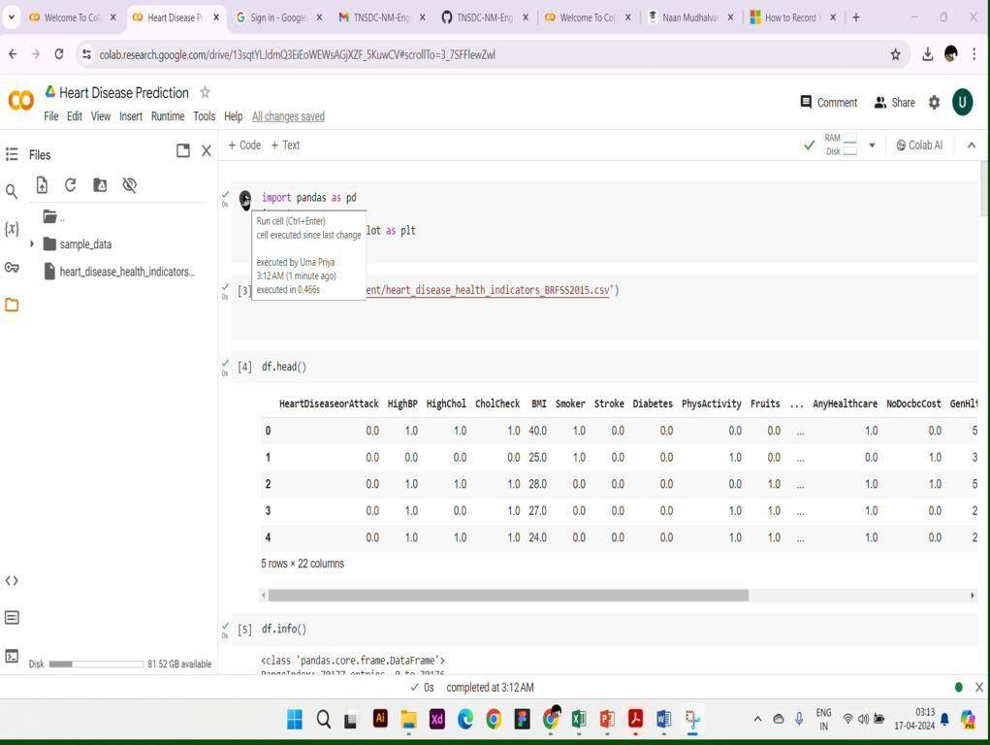
Project Demo(Recorded Video)

Slide 8
Conclusion
Correlation-based Feature Subset Selection method with the Best First Search has been carried out to select the most significant features. It has been discovered that all of the features are not strongly connected and that a combination of just 14 features (age, gender, smoking, obesity, diet, physical activity, stress, chest pain type, previous chest pain, blood pressure diastolic, diabetes, troponin, ECG, and target) significantly contribute to the prediction of heart disease. Finally, the datasets containing his research has provided a comprehensive study of patient characteristics for heart all features and selected features are used to develop seven AI (logistic regression, Naïve Bayes, K-NN, SVM, decision tree, random forest, and MLP) methods

Slide 9
Future Scope
Precision Medicine**: Future approaches to predicting heart disease will likely rely more on **precision medicine**. This concept involves tailoring medical care, including prevention strategies, to individual differences in people's genes, environments, and lifestyles².
collaboration and Research**: Collaboration between researchers, clinicians, and data scientists is essential. Continued research, validation, and refinement of prediction models will drive progress in heart disease prevention and management.
. **Real-Time Monitoring**: Real-time monitoring of physiological parameters can alert healthcare providers to potential heart disease risks. Continuous monitoring using wearable devices and smart health applications will enable timely interventions.

Slide 10
References
See discussions, stats, and author profiles for this publication at:
https://www.researchgate.net/publication/331589020 Heart Disease Prediction System
Research Proposal · March 2019 CITATIONS
2
Heart disease prediction using machine learning algorithms
To cite this article: Harshit Jindal et al 2021 IOP Conf. Ser.: Mater. Sci. Eng. 1022 012072

Slide 11
THANK YOU

